Slide 1


Managed Security Service
Jorgensen Labs
Reporting Period: 15 December to 12 January 2026
CLIENT CONFIDENTIAL

Slide 2
Report Introduction
This monthly cyber security report highlights areas that require attention and / or mitigation actions that can help to advance the security posture of your environment.
The data presented herein is pulled from Mantix4’s Managed Security Service sources (SIEM, SentinelOne, NDR, and SOC), offering a comprehensive view of your organization's defenses.
Please note that certain risk mitigations (e.g., software patching) must be done with caution to ensure they do not impact service availability or integrity.
The raw statistics accompanying this report give deeper insights into the current security posture and ongoing improvements.
The NDR reports reflect filtered network data in an attempt to reduce noise and highlight anomalies.
‹#›

Slide 3
Cyber Insight Summary
The following key host-based observations and actions have been identified during the reporting period:
Critical Patch Management Findings:
Windows Systems: 5 missing Microsoft KB patches identified across the network.
Third-Party Software: 8 applications require updates to address potential vulnerabilities.
Recommendation: Ensure patching of Critical vulnerabilities are given priority. Top system risk scores are Sales systems. Especially if they are remote personnel, there needs to be a priority to update, upgrade and patch those computers.
‹#›

Slide 4
Service Coverage & Deployment
Endpoint Deployment (65 systems detected):
EPIC SIEM: 65 agents
SentinelOne XDR: Xerox-Managed
DFIR Agent: Not Subscribed
Network Detection & Response (NDR): Active, 2 Sites (8th Street, VanBuren)
MS365 Cloud Coverage:
Active user accounts: 120
Vulnerability Management:
Host-Based (OS / 3rd Party SW) : 65 systems reporting
Network-Based (Perimeter): Subscribed*
Internal Network: Subscribed
Security Operations Center (SOC) 24x7: Active
*HQ: 96.88.84.241 8th Street: 204.133.131.210
‹#›
Notes:
MS365 users in CLIRSec Reporting Dashboard at bottom of page

Slide 5
Service Statistics
30,153,211
1,185
6
0
Raw Telemetry
Key Detections
SOC Tickets
Analyst Investigations
Total number of raw events ingested into the SIEM and NDR during the reporting period.
Detections involving critical or high severity events, issues and behaviors.
Tickets generated by the 24x7 SOC involving notable activities requiring confirmation from the client.
Investigative actions, including deeper analysis of contextual sources (e.g. DFIR).
** Raw Telemetry Source Events:
Endpoint (SIEM): 3,376,608
Network (NDR): 26,631,242*
Cloud (MS365): 145,361
*The NDR value is an estimate based on typical traffic rates in this time period
‹#›

Slide 6
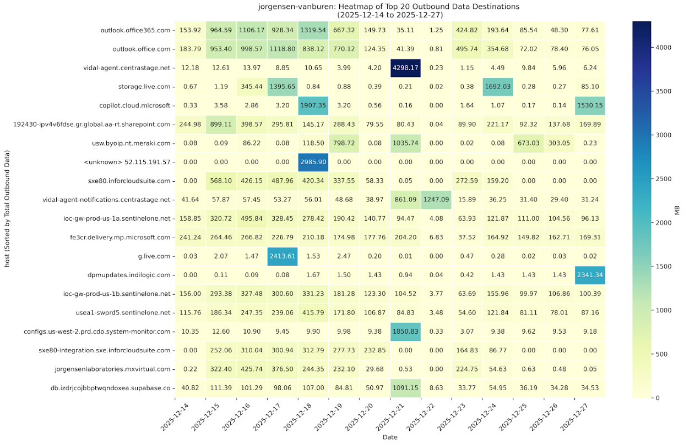
NDR (VanBuren) - Top Outbound Data Destinations (1st)
‹#›

Slide 7
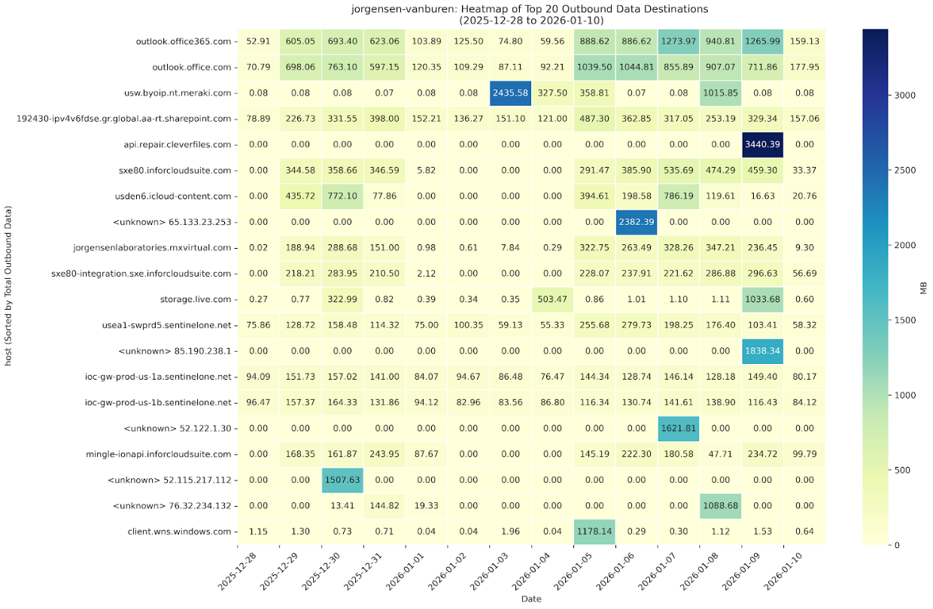
NDR (VanBuren) - Top Outbound Data Destinations (2nd)
‹#›

Slide 8
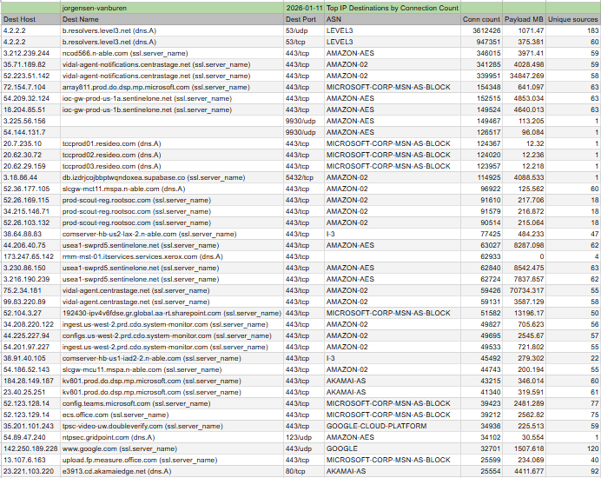
NDR (VanBuren) - Top IP Destinations by Connection Count
‹#›

Slide 9
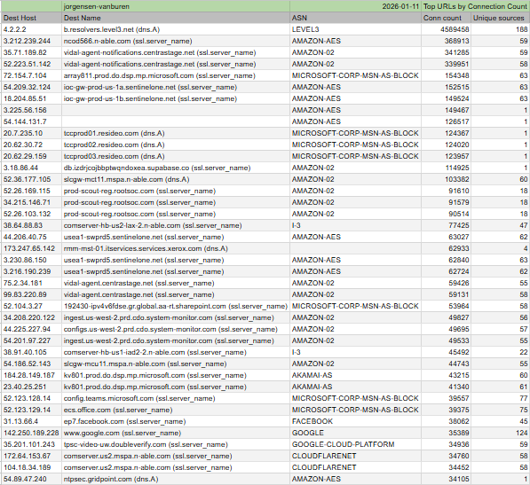
NDR (VanBuren) - Top URLs by Connection Count
‹#›

Slide 10
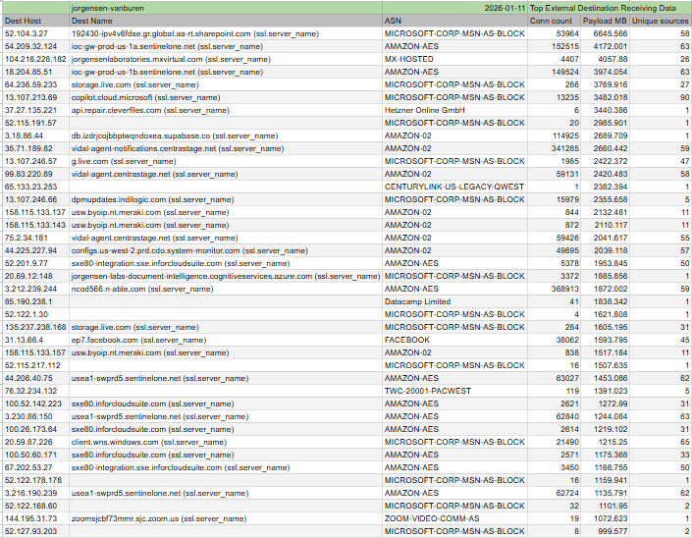
NDR (VanBuren) - Top External Destination Receiving Data
‹#›

Slide 11
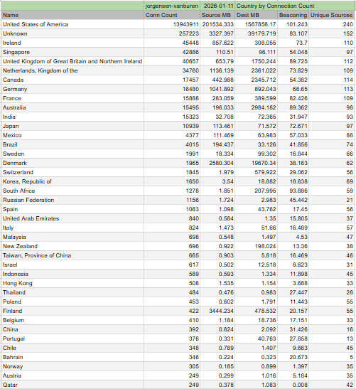
NDR (VanBuren) - Country by Connection Count
‹#›

Slide 12
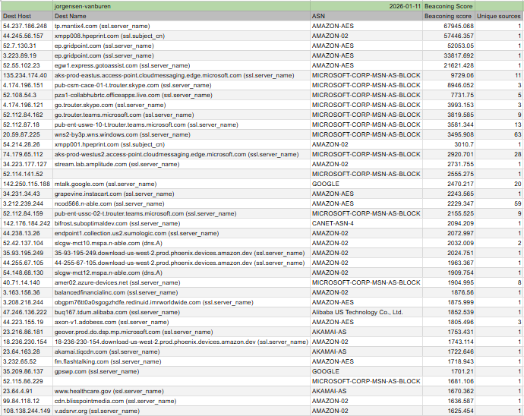
NDR (VanBuren) - Beaconing Score
‹#›

Slide 13
NDR (VanBuren) - Sensitive Data
‹#›

Slide 14
NDR (VanBuren) - Internal Network Vulnerabilities
The internal network subnets were scanned for network vulnerabilities (not host based software vulnerabilities) from the Mantix4 Sensor. The following were identified (Reported as [Category] [Protocol] [Severity] Issue Description):
[zebra-default-login] [http] [high] http://192.168.1.121/authorize [password="1234",username="admin"]
Issue: The Zebra device is accessible over HTTP using default admin credentials (admin/1234), allowing unauthorized access and device compromise.
2. [snmpv1-community-detect-string] [javascript] [high] 10.200.10.46:161 ["EPSON4A6AC3"],
192.168.1.121:161 ["ZT411"], 192.168.1.107:161 ["NPIEDFB0D"], 192.168.1.140:161 ["MP C6503"], 192.168.1.209:161, 192.168.1.177:161 ["NPIC2E03A"], 192.168.1.45:161 ["HPA5BAAE"], 192.168.1.90:161 ["IP C8500"] [community_string="public"]
Issue: multiple devices expose SNMPv1 using the default public community string, allowing unauthorized users to read or modify device information over an insecure protocol.
‹#›

Slide 15
NDR (VanBuren) - Internal Network Vulnerabilities(cont.)
The internal network subnets were scanned for network vulnerabilities (not host based software vulnerabilities) from the Mantix4 Sensor. The following were identified (Reported as [Category] [Protocol] [Severity] Issue Description):
3. [mfp-unauth-exposure] [http] [medium] https://192.168.1.209, 192.168.1.45/eSCL/ScannerCapabilities
["CN9CPKY01R", "CN9BIKY05W","HP OfficeJet Pro 9010 series", "HP PageWide Pro 477dw MFP"]
Issue: HP OfficeJet Pro MFP exposes scanner capabilities over HTTP/HTTPS without authentication, allowing unauthorized access to device information and scanning functions.
‹#›

Slide 16
NDR (VanBuren) - Internal Network Mitigation
1. Change the default username and password immediately
Disable HTTP and enable HTTPS only
Restrict web access to trusted IP addresses
Update device firmware to the latest version
2. Disable SNMPv1 completely
Enable SNMPv3 with authentication and encryption
Change the community string from public to a strong custom value
Limit SNMP access to trusted management systems only
‹#›

Slide 17
NDR (VanBuren) - Internal Network Mitigation(cont.)
3. Enable authentication for scanner and web services
Disable eSCL/AirScan if not required
Restrict access using firewall or IP filtering
Update printer firmware to the latest version
‹#›

Slide 18
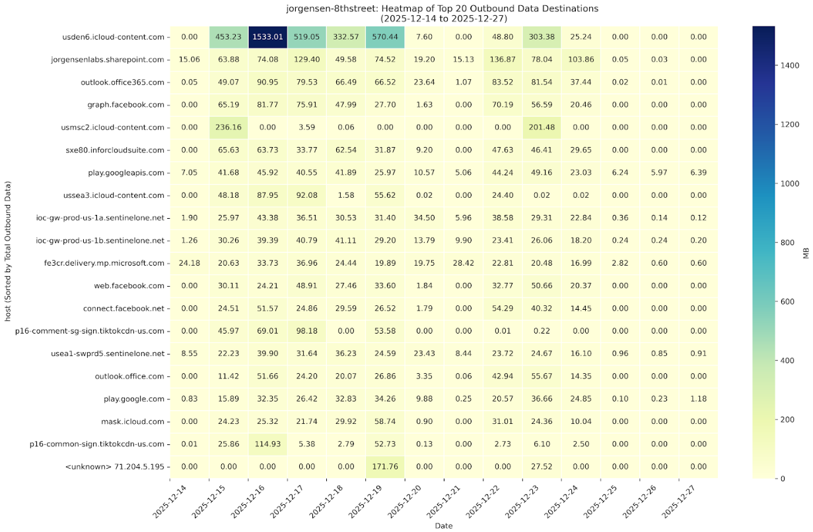
NDR (8th St) - Top Outbound Data Destinations (1st)
‹#›

Slide 19
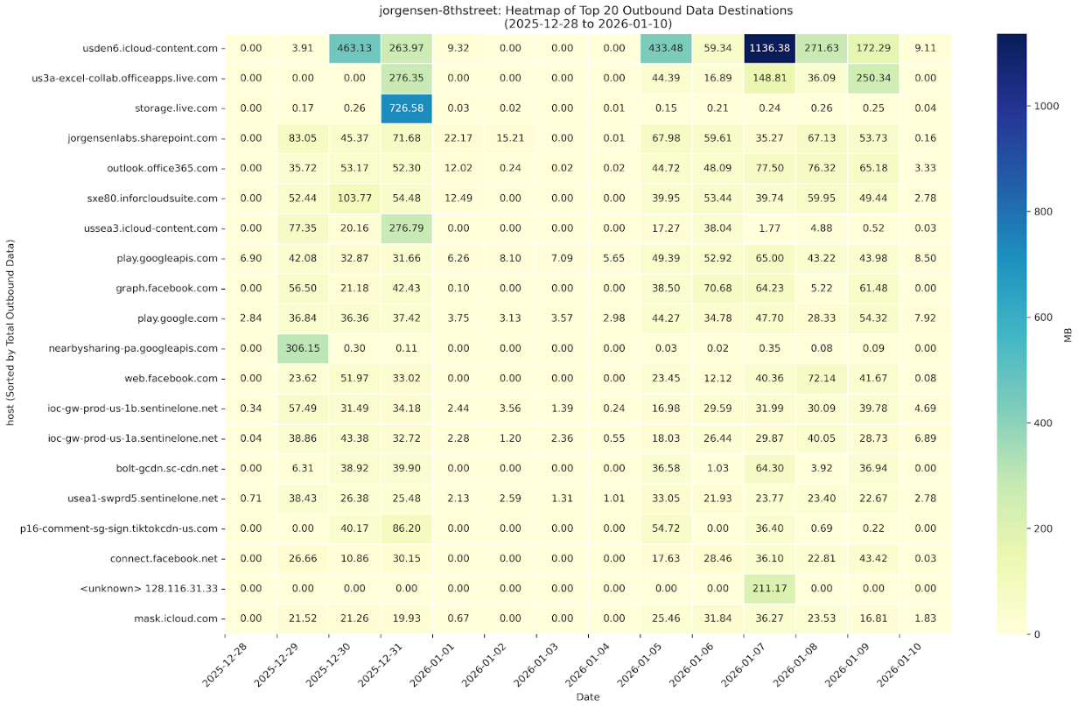
NDR (8th St) - Top Outbound Data Destinations (2nd)
‹#›

Slide 20
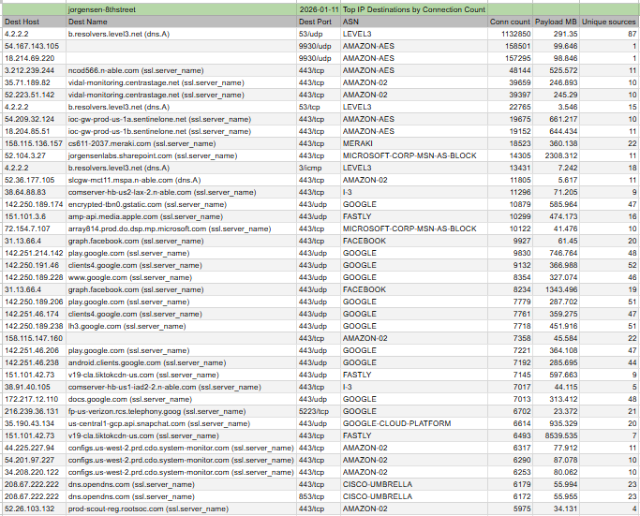
NDR (8th St) - Top IP Destinations by Connection Count
‹#›

Slide 21
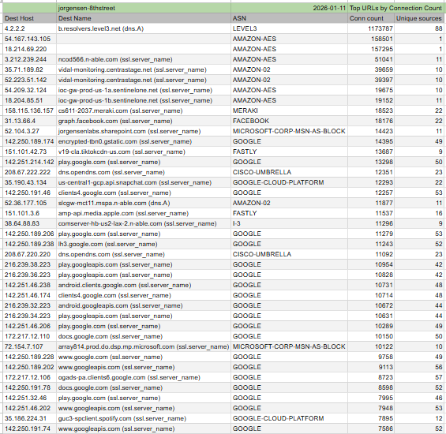
NDR (8th St) - Top URLs by Connection Count
‹#›

Slide 22
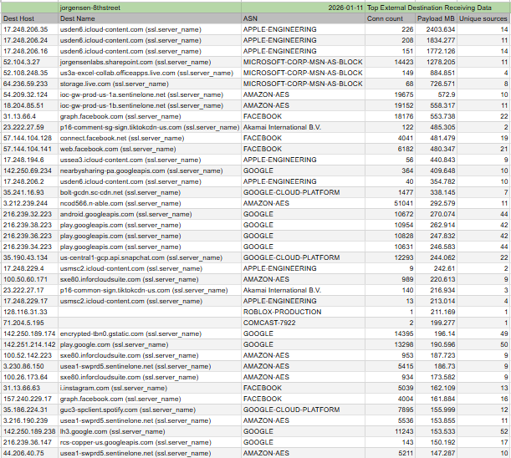
NDR (8th St) - Top External Destination Receiving Data
‹#›

Slide 23
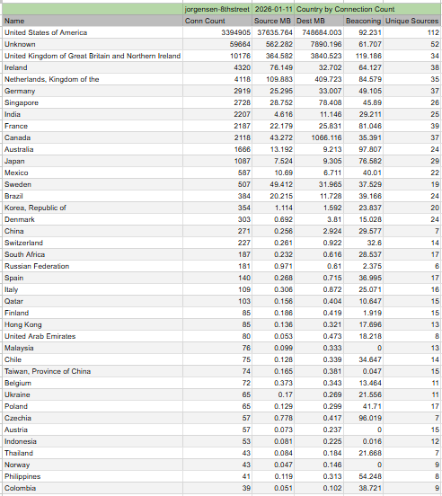
NDR (8th St) - Country by Connection Count
‹#›

Slide 24
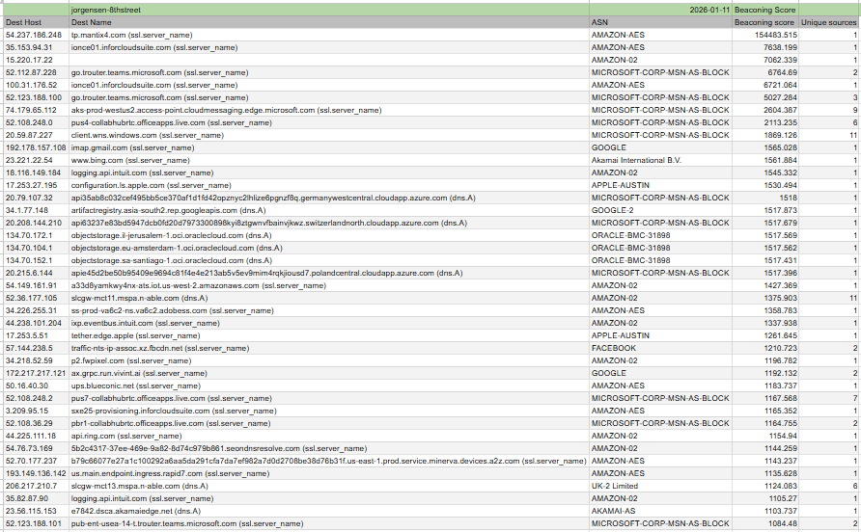
NDR (8th St) - Beaconing Score
‹#›

Slide 25
NDR (8th St) - Sensitive Data
Nothing to report!
‹#›

Slide 26
NDR (8th St) - Internal Network Vulnerabilities
The internal network subnets were scanned for network vulnerabilities (not host based software vulnerabilities) from the Mantix4 Sensor. The following were identified (Reported as [Category] [Protocol] [Severity] Issue Description):
[zebra-default-login] [http] [high] http://192.168.15.98/authorize [password="1234",username="admin"]
Issue: The Zebra device is accessible over HTTP using default admin credentials (admin/1234), allowing unauthorized access and device compromise.
2. [mfp-unauth-exposure] [http] [medium] https://192.168.15.250/eSCL/ScannerCapabilities ["HP
OfficeJet Pro 9010 series","TH3947811H"]
Issue: HP OfficeJet Pro MFP exposes scanner capabilities over HTTP/HTTPS without authentication,
allowing unauthorized access to device information and scanning functions.
‹#›

Slide 27
NDR (8th St) - Internal Network Mitigation
1. Change the default username and password immediately
Disable HTTP and enable HTTPS only
Restrict web access to trusted IP addresses
Update device firmware to the latest version
2. Enable authentication for scanner and web services
Disable eSCL/AirScan if not required
Restrict access using firewall or IP filtering
Update printer firmware to the latest version
‹#›

Slide 28
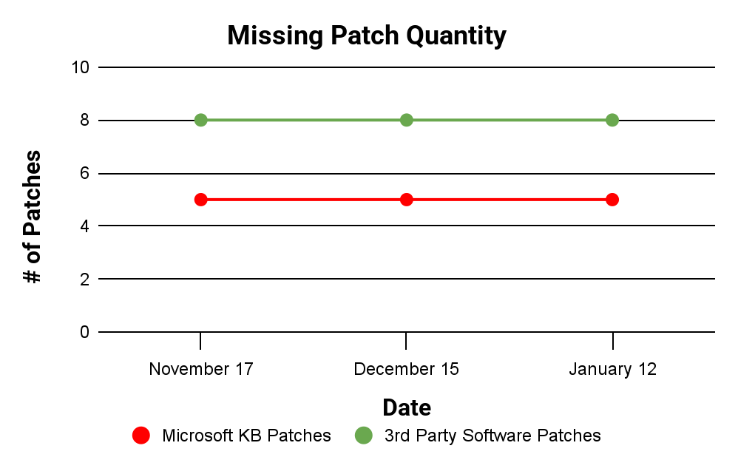
Required Software Patches
There are currently 5 Microsoft KB patches that need to be deployed
There are 8 software packages that require updating. Patching should be done with caution to ensure systems and applications are not negatively impacted.
‹#›

Slide 29
Top Software Patches
Package Name | Recommended Action
Adobe Reader XI MUI | Adobe Reader XI MUI - Update to higher than 11.0.22
Google Chrome | Google Chrome - Update to higher than 130.0.6723.69
Microsoft ASP.NET Core 5.0.0 Targeting Pack (x64) | Microsoft ASP.NET Core 5.0.0 Targeting Pack (x64) - Update to higher than 5.0.8
Microsoft ASP.NET Core 5.0.3 Shared Framework (x64) | Microsoft ASP.NET Core 5.0.3 Shared Framework (x64) - Update to higher than 5.0.8
Microsoft ASP.NET Core 6.0.21 Hosting Bundle Options | Microsoft ASP.NET Core 6.0.21 Hosting Bundle Options - Update to higher than 6.0.27
Mozilla Firefox (x64 en-US) | Mozilla Firefox (x64 en-US) - Update to higher than 131.0.2
Python 3.12.0 (64-bit) | Python 3.12.0 (64-bit) - Update to higher than 3.12.5
VLC media player | VLC media player - Update to higher than 3.0.20
Note:
All patching, particularly on servers, should be done with caution. Patches should be tested, and they should be assessed for compatibility prior to deployment.
‹#›

Slide 30
Top Microsoft Patches
Package Name | KB Patch
Windows 10 | KB5068781
Windows 11 | KB5044280 KB5068865 KB5068861
Windows Server 2016 | KB5068864
Note:
All patching, particularly on servers, should be done with caution. Patches should be tested, and they should be assessed for compatibility prior to deployment.
‹#›

